Slide 1
Fully Convolutional Networks for Semantic Segmentation
key insight: build “fully convolutional” networks that take input of arbitrary size and produce correspondingly-sized output.
deﬁne and detail the space of fully convolutional networks
deﬁne a novel architecture that combines semantic information from a deep, coarse layer with appearance information from a shallow, ﬁne layer to produce accurate and detailed segmentations.
Notes:
核心观点是建立“全卷积”网络，输入任意尺寸，经过有效的推理和学习产生相应尺寸的输出
定义并指定全卷积网络的空间
定义了一个跳跃式的架构，结合来自深、粗层的语义信息和来自浅、细层的表征信息来产生准确和精细的分割

Slide 2
1. Introduction
Convolutional networks:
whole-image classiﬁcation [19, 31, 32]
bounding box object detection [29, 12, 17]
part and keypoint prediction [39, 24]
local correspondence [24, 9]
The natural next step in the progression from coarse to ﬁne inference is to make a prediction at every pixel.
Notes:
卷积网: 全图式的分类 [19, 31, 32] , 目标检测边界框 [29, 12, 17] 、部分和关键点预测 [39, 24] 和局部通信 [24, 9]
在从粗糙到精细推理的进展中下一步自然是对每一个像素进行预测

Slide 3
1. Introduction
this is the ﬁrst work to train FCNs end-to-end (1) for pixelwise prediction and (2) from supervised pre-training.
Fully convolutional versions of existing networks predict dense outputs from arbitrary-sized inputs.
Both learning and inference are performed whole-image-ata-time by dense feedforward computation and backpropagation.
In-network upsampling layers enable pixelwise prediction and learning in nets with subsampled pooling.
Notes:
这是第一次训练端到端(1)的FCN在像素级别的预测，而且来自监督式预处理(2)。
全卷积在现有的网络基础上从任意尺寸的输入预测密集输出。
学习和推理能在全图通过密集的前馈计算和反向传播一次执行。
网内上采样层能在像素级别预测和通过下采样池化学习。

Slide 4
2. Relatedwork
Fully convolutional networks:
the idea of extending a convnet to arbitrary-sized inputs ﬁrst appeared in Matan et al. [25]
WolfandPlatt [37] expand convnet outputs to 2-dimensional maps of detection scores for the four corners of postal address blocks.
Ning et al. [27] deﬁne a convnet for coarse multiclass segmentation of C. elegans tissues with fully convolutional inference.
Fullyconvolutionalcomputationhasalsobeenexploited in the present era of many-layered nets.
Notes:
第一次将卷积网扩展到任意尺寸的输入的是Matan等人
Wolf和Platt [37] 将卷积网输出扩展到来检测邮政地址块的四角得分的二维图
Ning等人 [27] 定义了一种卷积网络用于秀丽线虫组织的粗糙的、多分类分割，基于全卷积推理
全卷积计算也被用在现在的一些多层次的网络结构中。

Slide 5
2. Relatedwork
Dense prediction with convnets:
small models restricting capacity and receptive ﬁelds
patchwise training [27, 2, 8, 28, 11].
post-processingbysuperpixelprojection,randomﬁeld regularization, ﬁltering, or local classiﬁcation [8, 2, 11].
input shifting and output interlacing for dense output [28, 11] as introduced by OverFeat [29]
multi-scale pyramid processing [8, 28, 11]
saturating tanh nonlinearities [8, 5, 28]
ensembles [2, 11]
Notes:
基于卷积网的dense prediction
限制容量和接收域的小模型
patchwise训练 [27, 2, 8, 28, 11]
超像素投影的预处理，随机场正则化、滤波或局部分类 [8, 2, 11]
输入移位和dense输出的隔行交错输出 [11, 28, 29]
多尺度金字塔处理 [8, 28, 11]
饱和双曲线正切非线性 [8, 5, 28]
集成 [2,11]

Slide 6


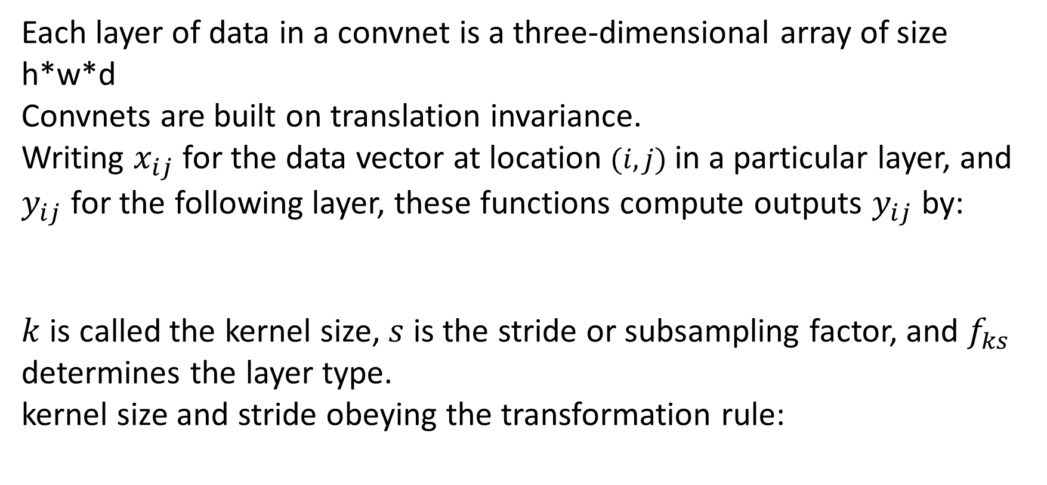
3. Fullyconvolutionalnetworks
Each layer of data in a convnet is a three-dimensional array of size h*w*d
Convnets are built on translation invariance.
Writing $x_{ij}$ for the data vector at location $(i, j)$ in a particular layer, and $y_{ij}$ for the following layer, these functions compute outputs $y_{ij}$ by:
$k$ is called the kernel size, $s$ is the stride or subsampling factor, and $f_{ks}$ determines the layer type.
kernel size and stride obeying the transformation rule:
Notes:
convnet中的每一层数据都是尺寸为h×w×d的三维数组
Convnets建立在翻译不变性的基础上
在特定层中的位置（i，j）处为数据矢量写入xij，并且针对后一层中的yij，这些函数将计算输出yij
k称为内核大小，s是步长或二次采样因子，fks决定图层类型
内核大小和步幅遵守转换规则

Slide 7
3.1. Adaptingclassiﬁersfordenseprediction
The fully connected layers of some typical recognition nets, including LeNet [21], AlexNet [19], and its deeper successors [31, 32], have ﬁxed dimensions and throw away spatial coordinates.
Doing so casts them into fully convolutional networks that take input of any size and output classiﬁcation maps.
While our reinterpretation of classiﬁcation nets as fully convolutional yields output maps for inputs of any size, the output dimensions are typically reduced by subsampling.
Notes:
典型的识别网络，包括LeNet [23] , AlexNet [22] , 和一些后继者 [34, 35] ，表面上采用的是固定尺寸的输入产生了非空间的输出。这些网络的全连接层有确定的位数并丢弃空间坐标。
需要将它们加入到可以采用任何尺寸输入并输出分类图的全卷积网络中
当我们将分类网络重新解释为任意输出尺寸的全卷积域输出图，输出维数也通过下采样显著的减少了

Slide 8
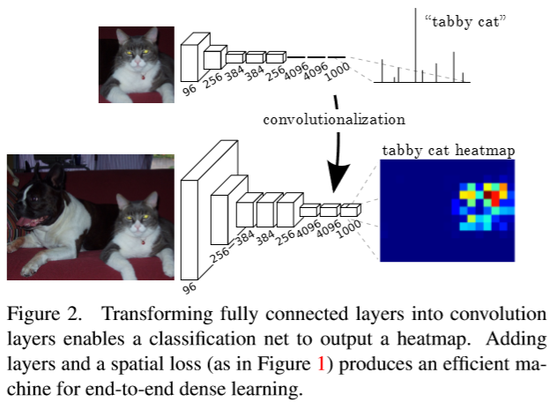
3.1. Adaptingclassiﬁersfordenseprediction
The fully connected layers of some typical recognition nets, including LeNet [21], AlexNet [19], and its deeper successors [31, 32], have ﬁxed dimensions and throw away spatial coordinates.
Doing so casts them into fully convolutional networks that take input of any size and output classiﬁcation maps.
While our reinterpretation of classiﬁcation nets as fully convolutional yields output maps for inputs of any size, the output dimensions are typically reduced by subsampling.
Notes:
在传统的CNN结构中，前5层是卷积层，第6层和第7层分别是一个长度为4096的一维向量，第8层是长度为1000的一维向量，分别对应1000个类别的概率。FCN将这3层表示为卷积层，卷积核的大小(通道数，宽，高)分别为（4096,1,1）、（4096,1,1）、（1000,1,1）。所有的层都是卷积层，故称为全卷积网络。

Slide 9
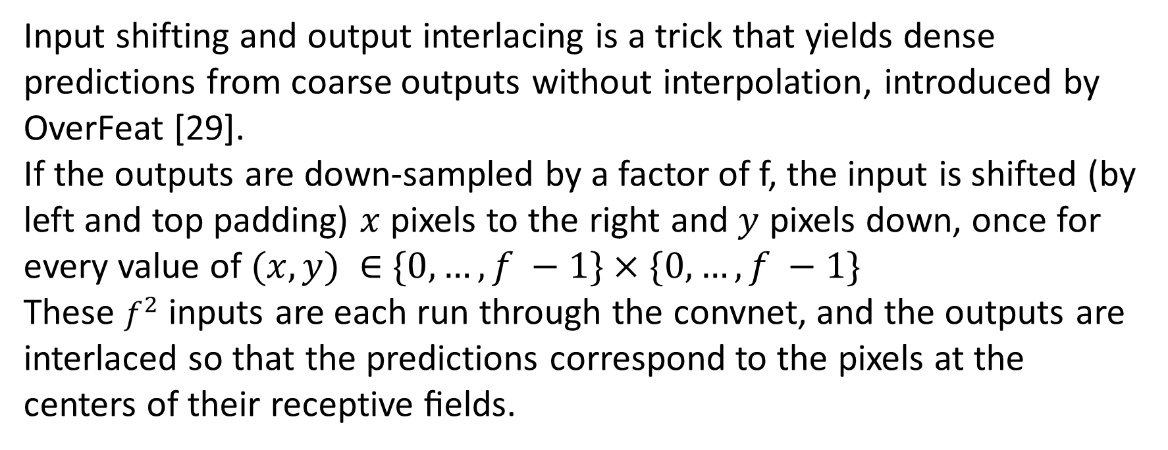
3.2. Shift-and-stitch is ﬁlter rarefaction
Input shifting and output interlacing is a trick that yields dense predictions from coarse outputs without interpolation, introduced by OverFeat [29].
If the outputs are down-sampled by a factor of f, the input is shifted (by left and top padding) $x$ pixels to the right and $y$ pixels down, once for every value of $(x,y) ∈$ $\{0,…,f −1\}×\{0,…,f −1\}$
These $f^{2}$ inputs are each run through the convnet, and the outputs are interlaced so that the predictions correspond to the pixels at the centers of their receptive ﬁelds.
Notes:
输入移位和输出交错是一种技巧，可以在没
有插值的情况下从粗略输出产生密集预测，由OverFeat [29]引入
如果输出是一个因子f 降低采样，平移输入的x像素(从左向右），y像素（从上到下），对于每个(x,y)满足0<=x,y<=f.
处理f^2个输入，并将输出交错以便预测和它们接收域的中心像素一致。

Slide 10

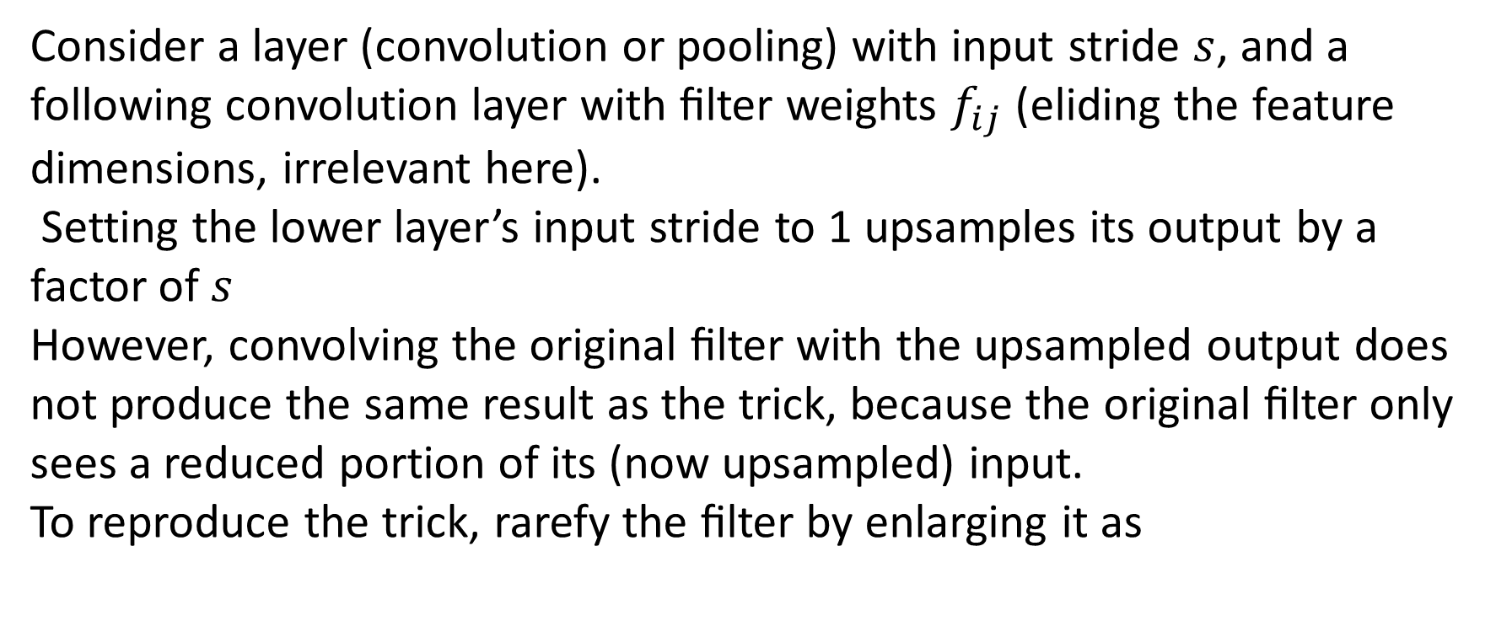
3.2. Shift-and-stitch is ﬁlter rarefaction
Consider a layer (convolution or pooling) with input stride $s$, and a following convolution layer with ﬁlter weights $f_{ij}$ (eliding the feature dimensions, irrelevant here).
Setting the lower layer’s input stride to 1 upsamples its output by a factor of $s$
However, convolving the original ﬁlter with the upsampled output does not produce the same result as the trick, because the original ﬁlter only sees a reduced portion of its (now upsampled) input.
To reproduce the trick, rarefy the ﬁlter by enlarging it as
Notes:
考虑一个层（卷积或者池化）中的输入步长s,和后面的滤波权重为f_ij的卷积层（忽略不相关的特征维数）。
设置更低层的输入步长到l上采样它的输出影响因子为s。
然而，将原始的滤波和上采样的输出卷积并没有产生和shift-and-stitch相同的结果，因为原始的滤波只看得到（已经上采样）输入的简化的部分。
为了重现这种技巧，扩大稀疏滤波

Slide 11
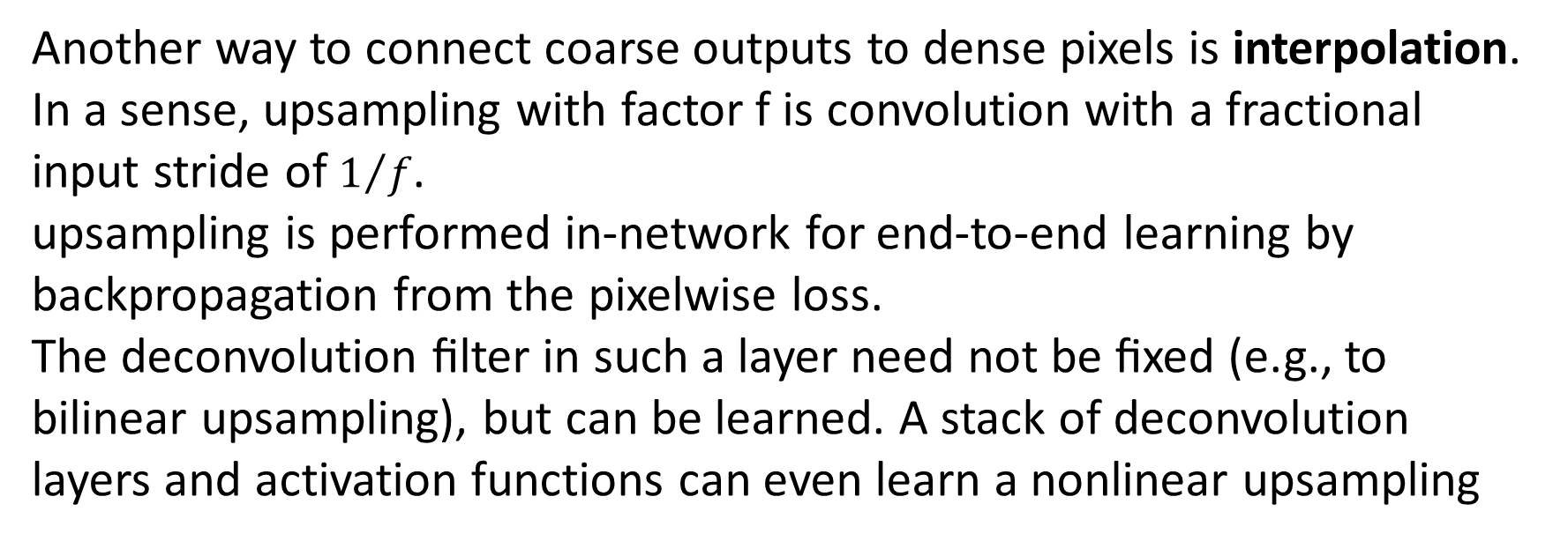
3.3. Upsampling is backwards strided convolution
Another way to connect coarse outputs to dense pixels is interpolation.
In a sense, upsampling with factor f is convolution with a fractional input stride of $1/f$.
upsampling is performed in-network for end-to-end learning by backpropagation from the pixelwise loss.
The deconvolution ﬁlter in such a layer need not be ﬁxed (e.g., to bilinear upsampling), but can be learned. A stack of deconvolution layers and activation functions can even learn a nonlinear upsampling
Notes:
另一种连接粗糙输出到dense像素的方法就是插值法
从某种意义上，伴随因子f的上采样是对步长为1/f的分数式输入的卷积操作。
上采样在网内通过计算像素级别的损失的反向传播用于端到端的学习
去卷积滤波在这种层面上不需要被固定不变（比如双线性上采样）但是可以被学习。
一堆反卷积层和激励函数甚至能学习一种非线性上采样

Slide 12
3.4. Patchwisetrainingislosssampling
Both patchwise training and fully-convolutional training can be made to produce any distribution.
While this is more efﬁcient than uniform sampling of patches, it reduces the number of possible batches.
If the kept patches still have signiﬁcant overlap, fully convolutional computation will still speed up training.
If gradients are accumulated over multiple backward passes, batches can include patches from several images.
Sampling in patchwise training can correct class imbalance [27, 8, 2] and mitigate the spatial correlation of dense patches [28, 16]
Notes:
patchwise 训练和全卷积训练能被用来产生任意分布
当这种方式比patches的均匀取样更加高效的同时，它减少了可能的批次数量
如果保存下来的patches依然有重要的重叠，全卷积计算依然将加速训练。
如果梯度在多重逆推法中被积累，batches能包含几张图的patches。
patcheswise训练中的采样能纠正分类失调 [27, 8, 2] 和减轻密集空间相关性的影响[28, 16]。

Slide 13
4. Segmentation Architecture
Both patchwise training and fully-convolutional training can be made to produce any distribution.
While this is more efﬁcient than uniform sampling of patches, it reduces the number of possible batches.
If the kept patches still have signiﬁcant overlap, fully convolutional computation will still speed up training.
If gradients are accumulated over multiple backward passes, batches can include patches from several images.
Sampling in patchwise training can correct class imbalance [27, 8, 2] and mitigate the spatial correlation of dense patches [28, 16]
Notes:
patchwise 训练和全卷积训练能被用来产生任意分布
当这种方式比patches的均匀取样更加高效的同时，它减少了可能的批次数量
如果保存下来的patches依然有重要的重叠，全卷积计算依然将加速训练。
如果梯度在多重逆推法中被积累，batches能包含几张图的patches。
patcheswise训练中的采样能纠正分类失调 [27, 8, 2] 和减轻密集空间相关性的影响[28, 16]。

